Slide 1
Machine Learning
Brunch & Learn
Multiple Linear Regression

Slide 2
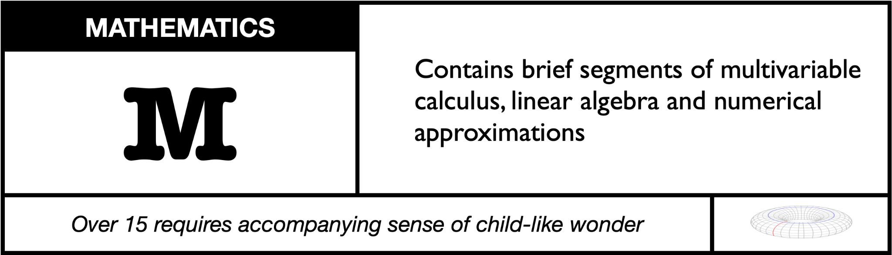

Slide 3
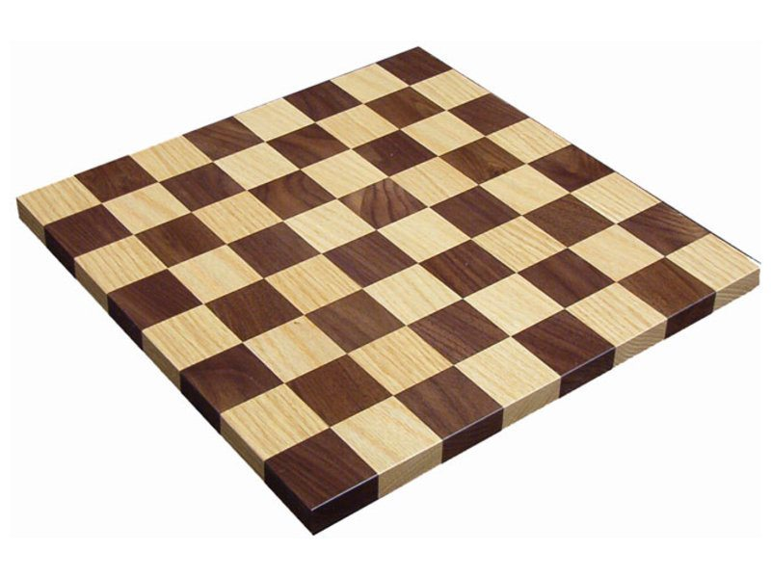
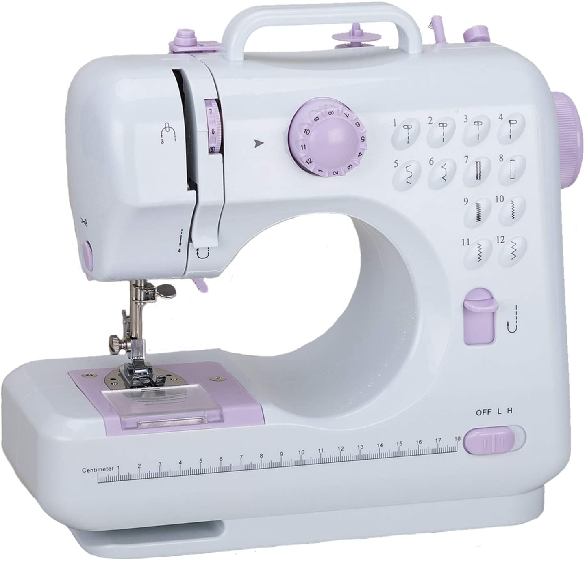
Glossary, because everyone loves vague jargon!
Feature: a number that captures some characteristic
(can be categorical or continuous)
Independent variable: input for a model
Example: a list of features for a single entity
Dependent variable: output from a model
Data: a collection of examples

Slide 4
Multiple Linear Regression: try to build a linear* model (relationship) between the independent variables and the dependent variable.
* and sometimes some cleverly
non-linearish models too

Slide 5
Linear Relationship for 1 independent variable

Slide 6
Loss/Cost for a guess

Slide 7
Gradient descent, where the machine learns, kind of

Slide 8
Linear Relationship with oodles of independent variables

Slide 9
Loss/Cost for a guess

Slide 10
Gradient descent, where the machine learns, kind of

